Slide 1

Diya Panthulu | Pine View School | Hali Flahavan
Evaluating Multi-Stage Filtration Efficiency
In A Low-Cost Solar-Powered Water Filtration System
17 December 2025

Slide 2
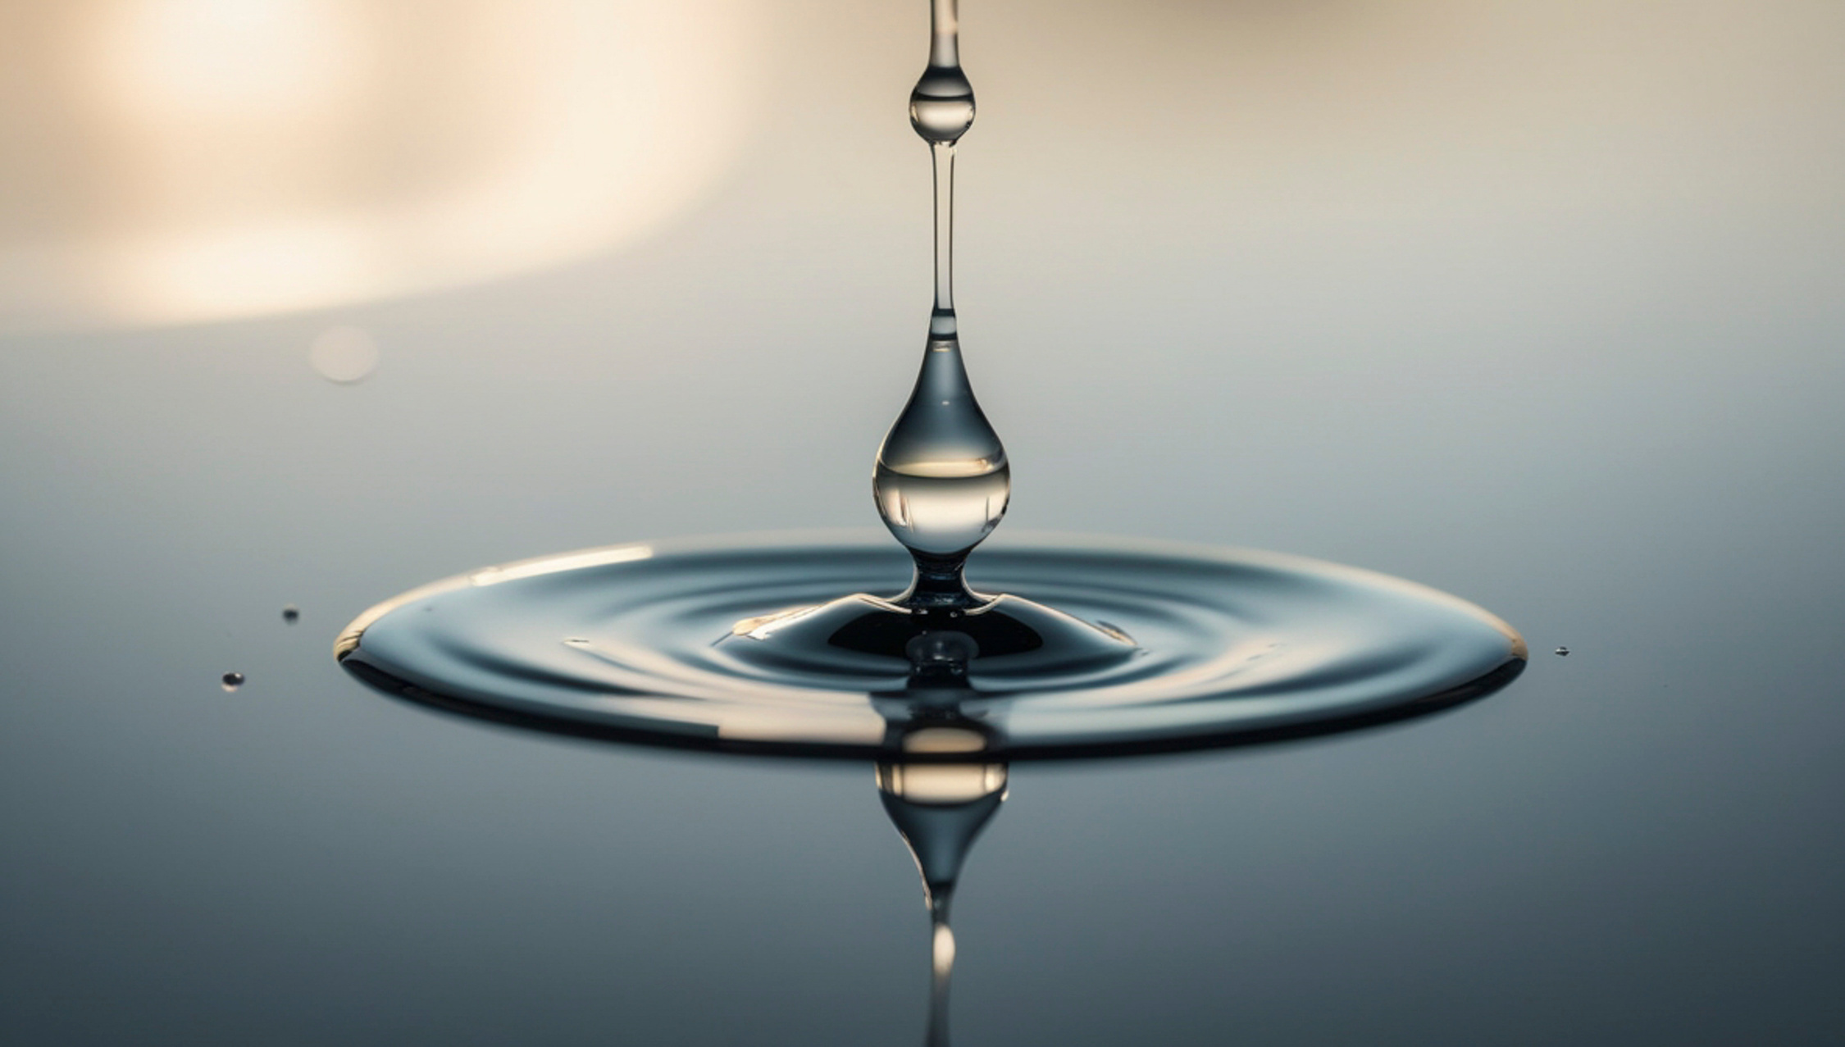
Problem & Background
Purpose: This research matters because access to water is a fundamental human right, recognized by the UN, yet around 2.1 billion people globally lack it. [9,17] Proper water filtration systems are key to solving this problem, and that’s what this project aims to engineer. [5]
Method overview: The goal of this design is to create a low-cost water filtration system that can efficiently filter pond water and turn it into safe drinking water on a large scale.
Impact: If successful, this water filter can be implemented throughout the world and provide clean water to multiple people at a time.
Photo provided by Canva

Slide 3

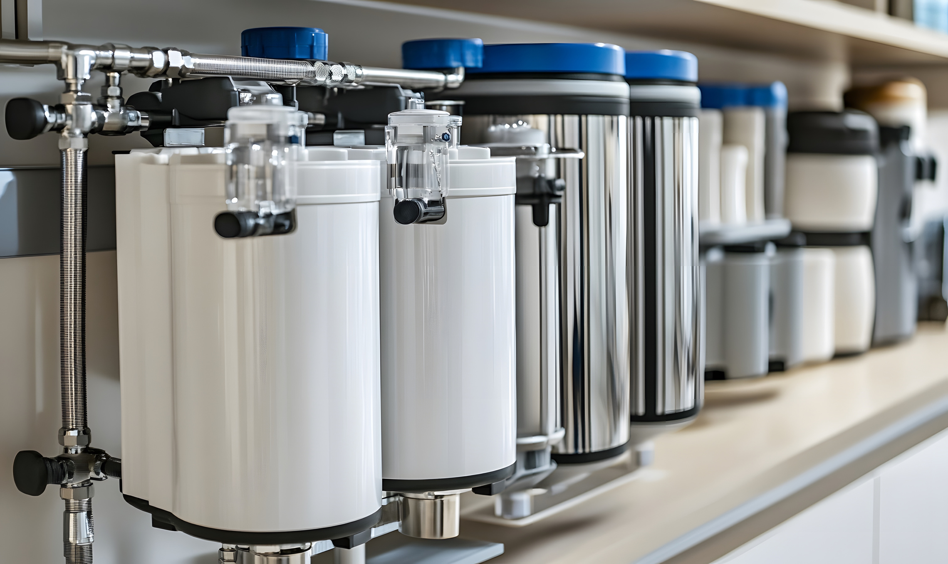
Scientific Motivation
Existing filtration systems in impoverished communities use cloth or ceramic to filter water, which only have a filter accuracy of 15-50 microns, and most bacteria falls in the range of 0.2 to 10 microns in size [12]. Existing systems are not safe enough to remove bacteria, posing a great health risk to users in the community.
Many industrial water filtration systems are too expensive to build, but this solar powered system hopes to solve this issue with relatively low equipment costs and no power cost.
Photos provided by Canva

Slide 4
Prior Research
LifeStraw
Relevance of the Study
Filtration Basics
A type of filter for personal use that filters pathogens from water as you drink it. While LifeStraw is extremely effective, personal use filtration systems are not the most effective way to provide a large amount of people with safe water. [6]
A sediment filter, a carbon filter (for taste), and a low micron filter must be utilized to ensure water is safe to drink; like LifeStraw.
LifeStraw uses important filtration techniques that may be implementable in the prototype, just at a larger scale.

Slide 5
Research Question
Can a low-cost solar-powered, multi-stage filtration system produce drinking-safe water from natural sources?

Slide 6


Engineering Criteria and Constraints
Needs Statement
This design must be able to safely filter water in a large-scale manner, without acquiring energy costs, and provide a water source for multiple people.
Criteria & Constraints
To prove effective, this water filtration system must be able to:
Filter out sediment and biological pathogens.
Operate on solar power
Maintain a safe and consistent flow rate: in the range of 5-40 mL/second
Constraints: This design is limited by cost, size, and feasablity.

Slide 7
Engineering Design
To design this prototype, research was conducted about different filtration systems, parts of filtration systems, and the requirements for safe water. The goal was to find the perfect balance between safe water and minimal components (to reduce cost).
At first, the student wanted to use a UV radiation mechanism to make water safe to drink. However, it was quickly realized that a UV system would be too costly and ineffective to be feasible [10].
After more research was conducted about LifeStraw, the multi-filter efficiency they had achieved was taken into consideration. [6]. Applying those principles to the design, the student came up with something that used multiple filters to get water to a level of safe drinking, solving the problem creatively on a large scale. After this breakthrough, components were chosen, materials were bought, and the iteration process was started.

Slide 8
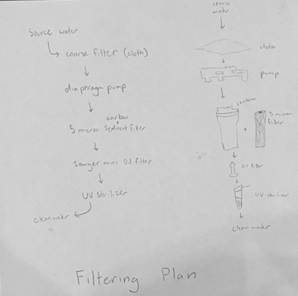
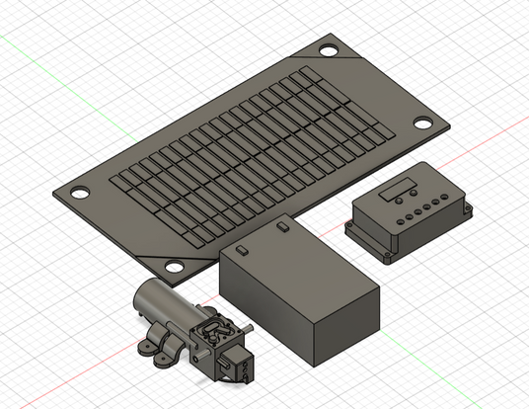
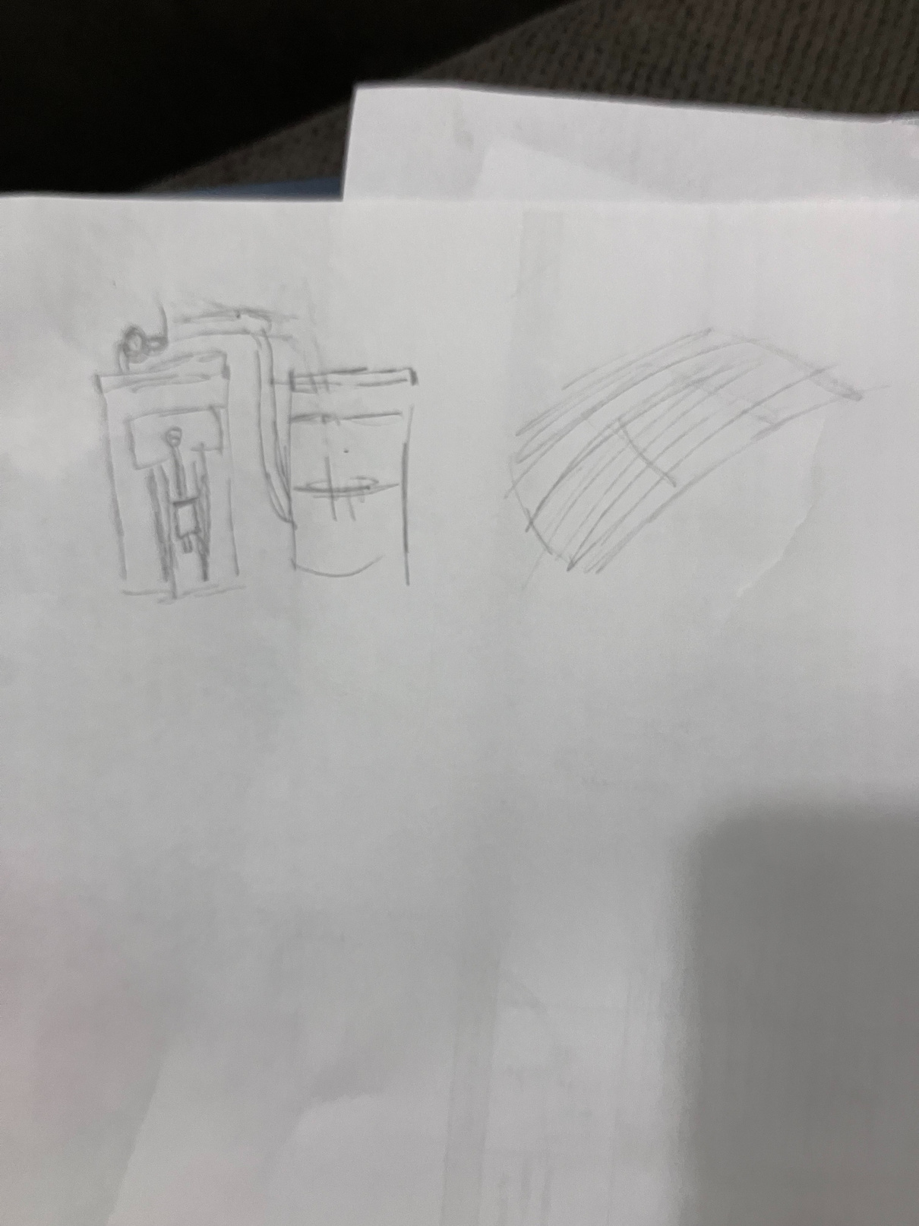
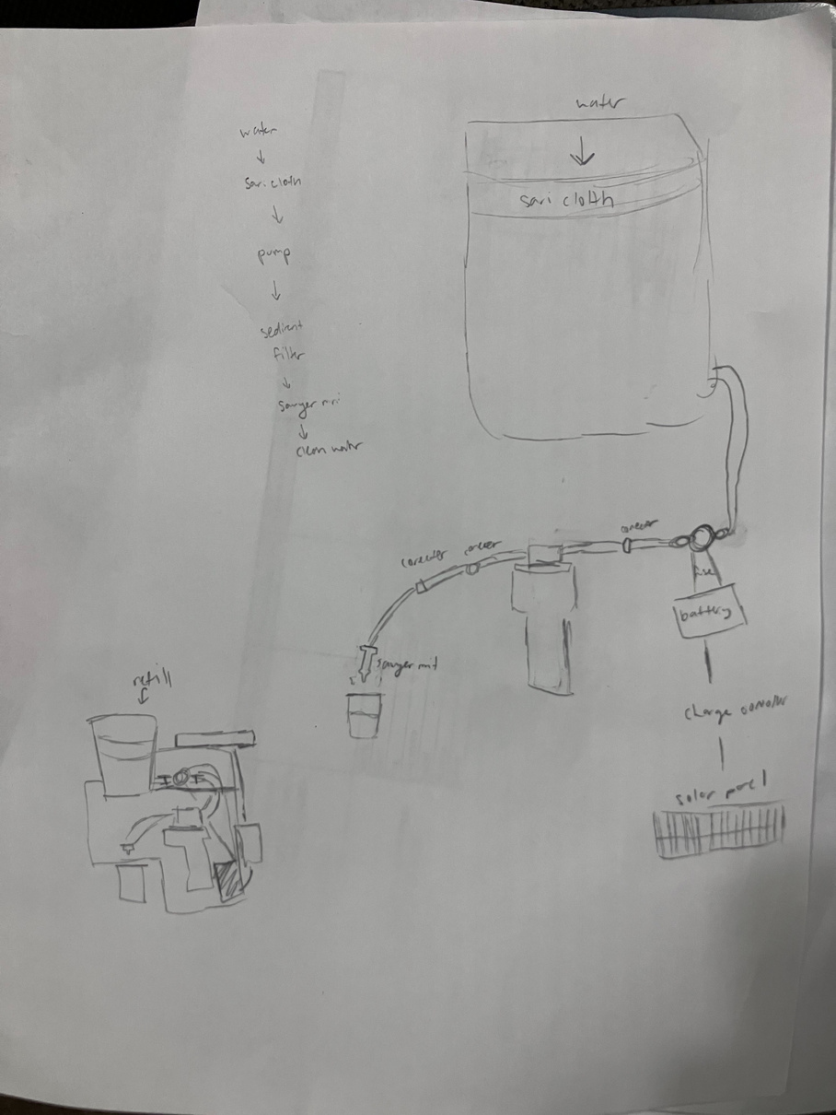
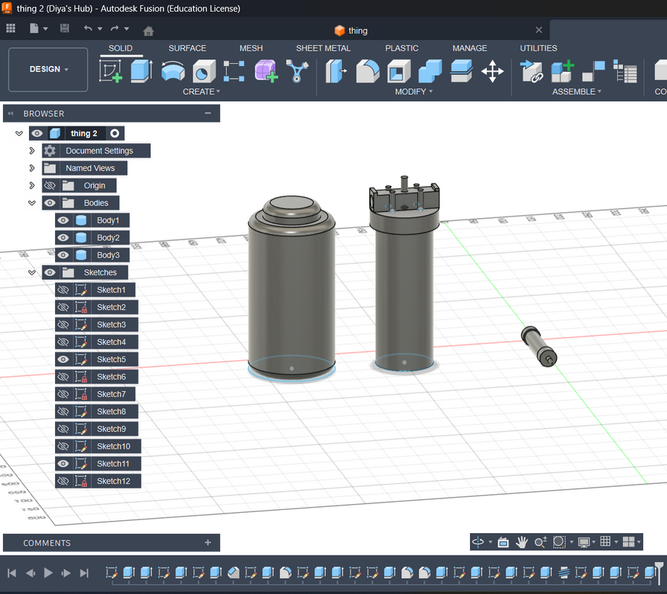
Engineering Design
Preliminary Sketches and Mockups
Key components
Wiring Plan
Battery
Solar Panel
Charge Controller
Diaphragm Pump
Charge Controller
Solar Panels
Diaphragm Pump
Battery
Filtration Plan
Source Water
Sediment/Carbon Filter
Source Water
Diaphragm Pump
Sediment/Carbon Filter
0.1 Micron Filter
0.1 Micron Filter
Screenshots taken by Diya Panthulu
Clean Water
Photos and drawings by Diya Panthulu

Slide 9
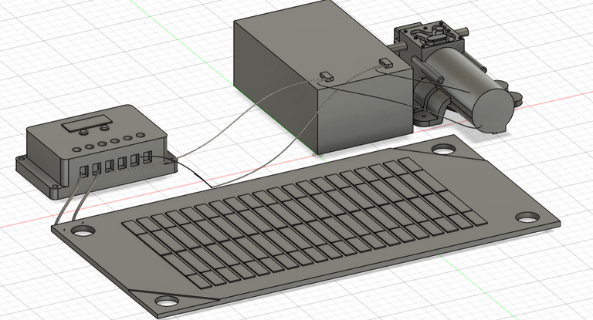
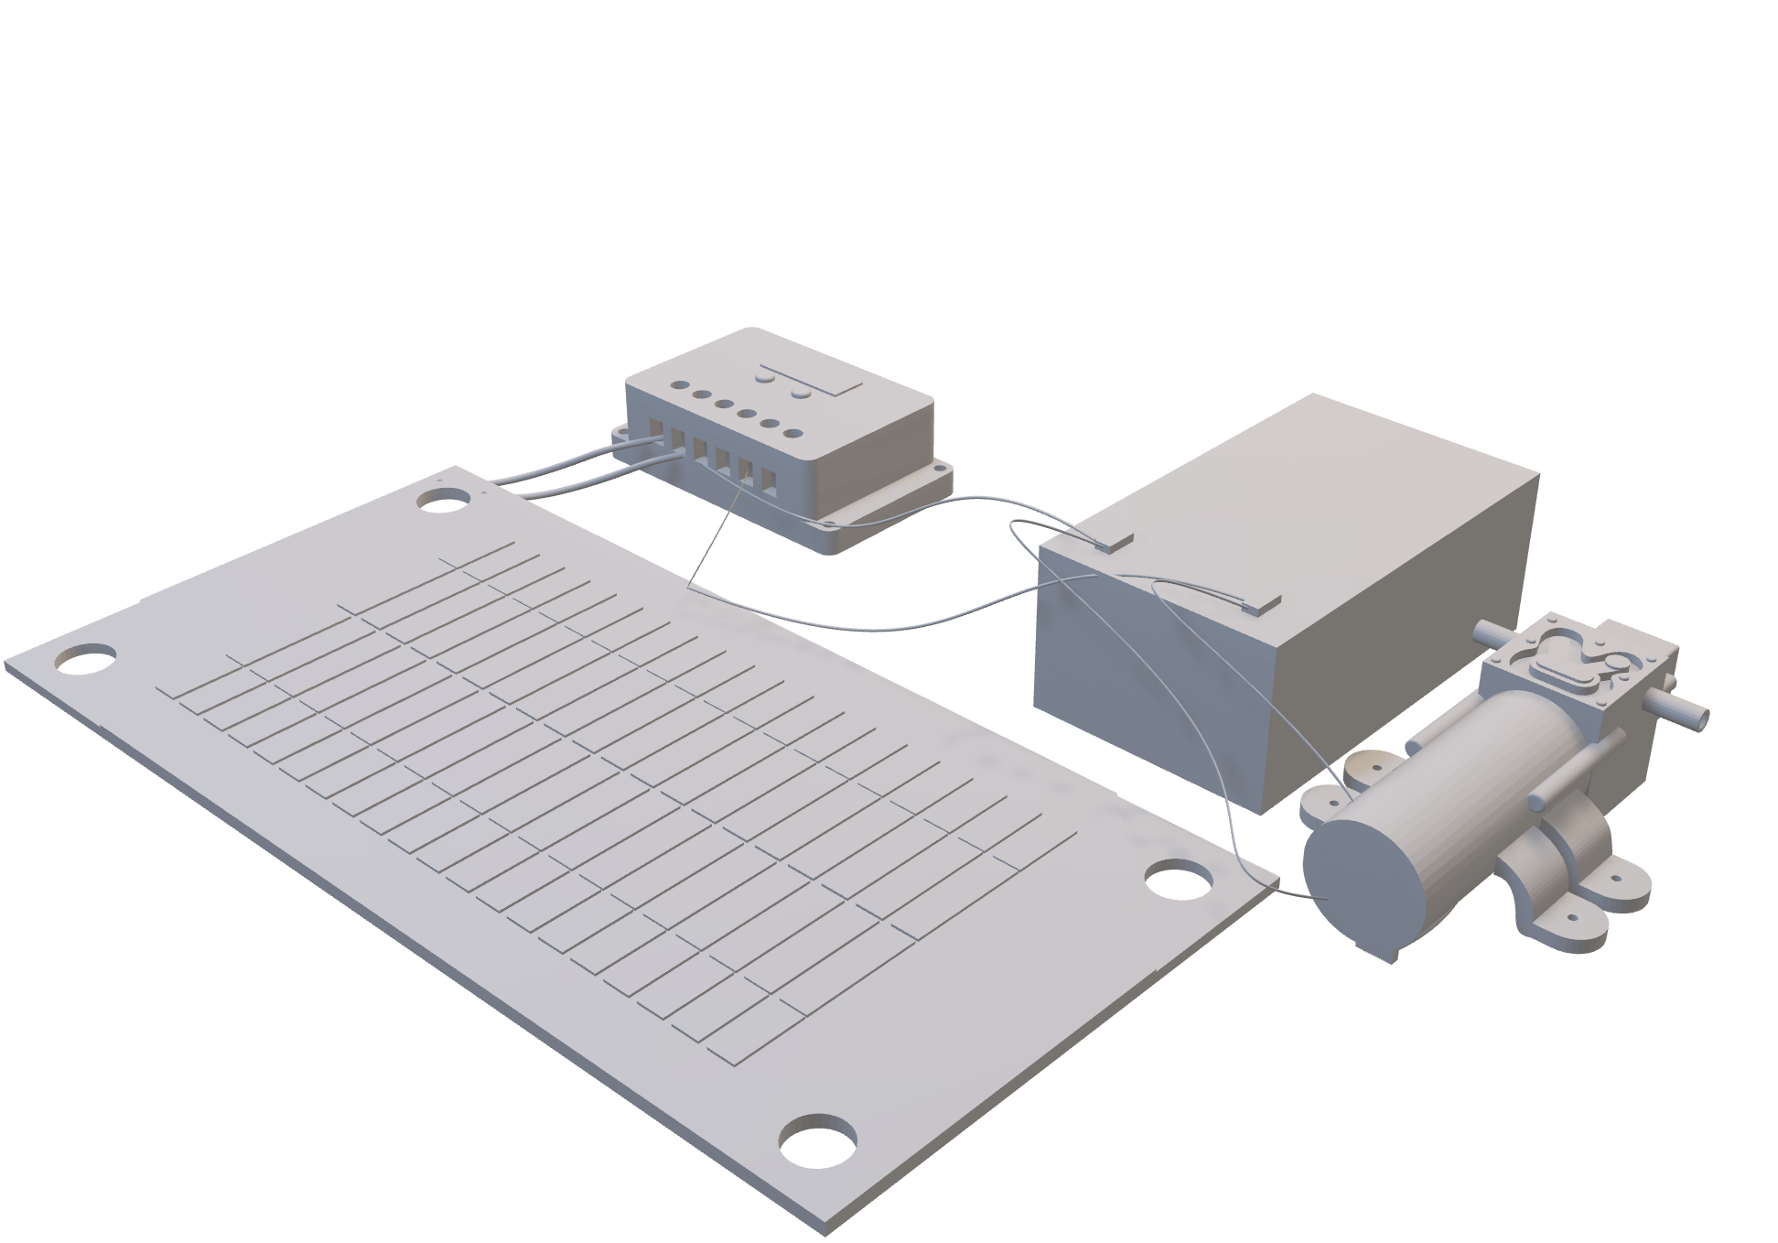
Engineering Design
Wired Cad Model
Screenshot taken by Diya Panthulu

Slide 10
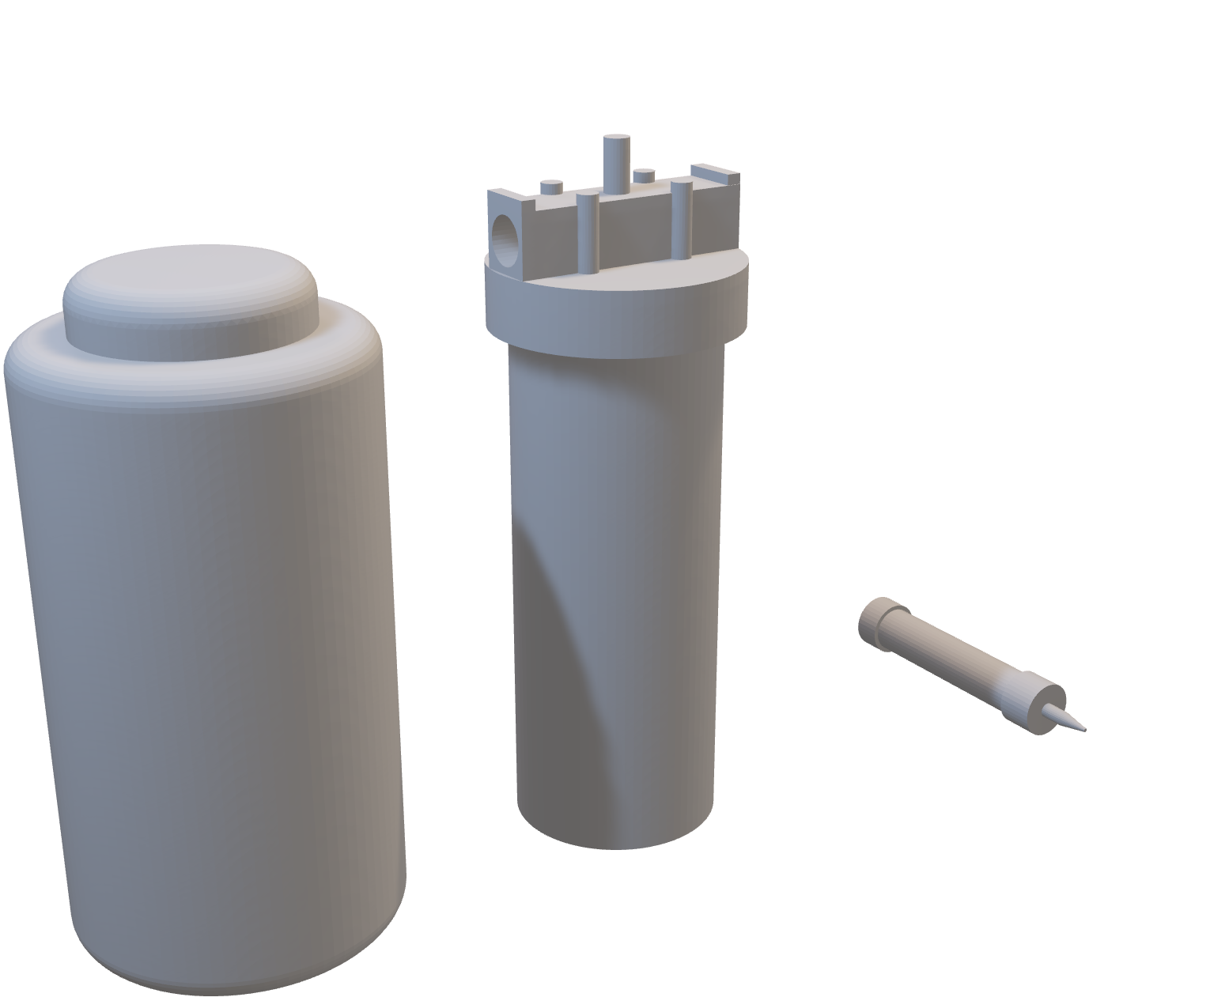
Engineering Design
Components Cad Model
Screenshot taken by Diya Panthulu

Slide 11


Materials and Components
Materials
12 V 10-Watt Solar Panel
0.1 Micron filter
12v 7ah rechargeable battery
2.5 in x 10 in 5-micron filter
⅜ in. OD RO water tubing
12V DC Diaphragm pump
Scissors
Wire Strippers
Wire Crimpers
PTFE tape
Hot Glue
⅜ in. NPT, 10 in. water filter housing
16 Gauge Wire
⅜ in. OD (outer diameter) x ⅜ Inch NPT Straight Adapter (Push to Connect fitting)
Female spade connectors
Electrical tape
10A Charge controller
⅜ in. to ¼ in. Barb reducer
½ in. ID (inner diameter), ⅜ in. ID, and ¼ in. ID vinyl tubing
¼ in. to ⅜ in. OD tube (push to connect fitting) Straight Male Thread Adapter
Removable Water Tank
Main Components
Diaphragm Pump
Solar Panels
Battery Backup
Preliminary Cloth
Sediment Filter
0.1 Micron filter
Removable Water Tank
Charge Controller

Slide 12
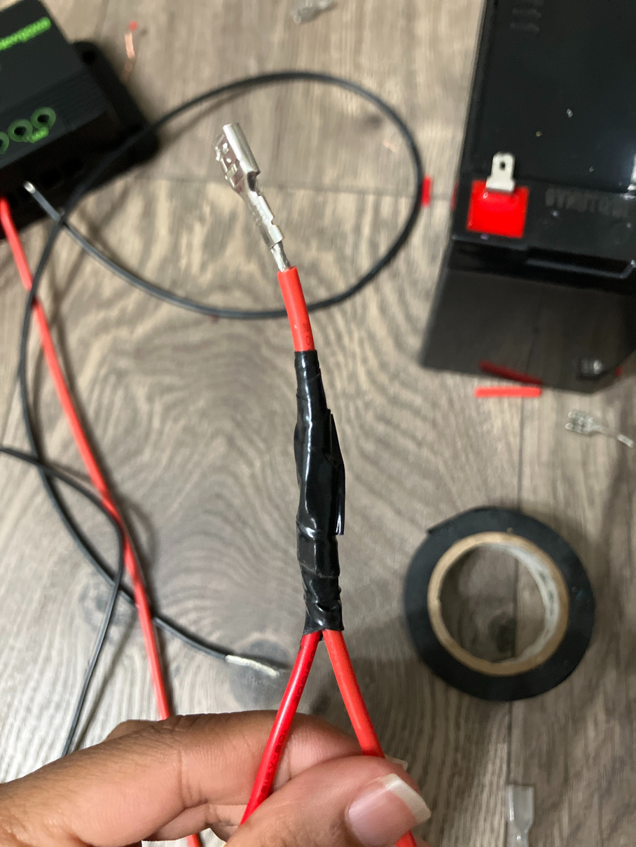
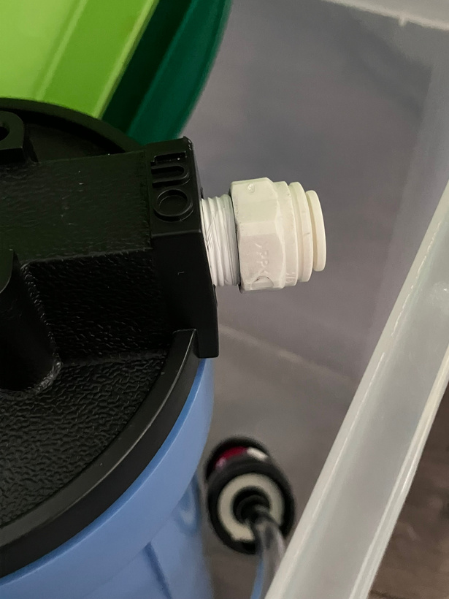
Procedure
Obtain all parts, tubing, and connectors.
Wire the battery backup, solar panels, charge controller, and diaphragm pump together using wire strippers and crimpers.
Strip the positive (red) and negative (black) wires from both the solar panel and diaphragm pump.
Combine the red wires together and the black wires together, securing each connection with electrical tape.
Cut and strip approximately 3 inches of additional red and black wire. Connect one end of each to the corresponding combined red and black wires, using electrical tape to seal the connection.
Crimp a female spade connector onto the free end of each 3-inch wire to allow connection to the battery terminal. View the image to the right and ensure your connection looks similar.
Connect the solar panel, battery, and diaphragm pump to the appropriate terminals on the charge controller according to the wiring diagram (on the engineering design slide.)
Connect the diaphragm pump inlet to the water tank using ⅜-inch vinyl tubing.
Connect the pump outlet to the sediment filter inlet using ⅜-inch vinyl tubing, a connector, ⅜-inch RO tubing, and a ⅜-inch NPT fitting.
Wrap PTFE (Teflon) tape or another NPT thread sealant around all NPT threads to ensure a watertight seal. View the image to the right and ensure your wrapping looks similar.
Attach a ⅜-inch NPT fitting and RO tubing to the sediment filter outlet.
Use a connector to transition from RO tubing back to vinyl tubing.
Install a ⅜-inch to ¼-inch barb reducer to decrease the tubing size.
Connect the reduced ¼-inch vinyl tubing to the 0.1-micron filter.
Power on the system and observe operation. Check all electrical connections and tubing joints for proper function and leaks, making adjustments as necessary. Hot glue and other tools may be used to secure components.
Photos taken by Diya Panthulu

Slide 13
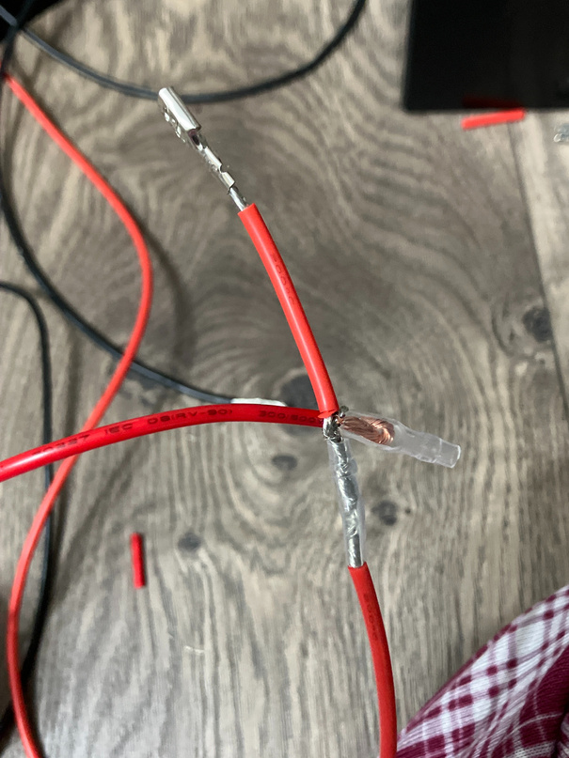
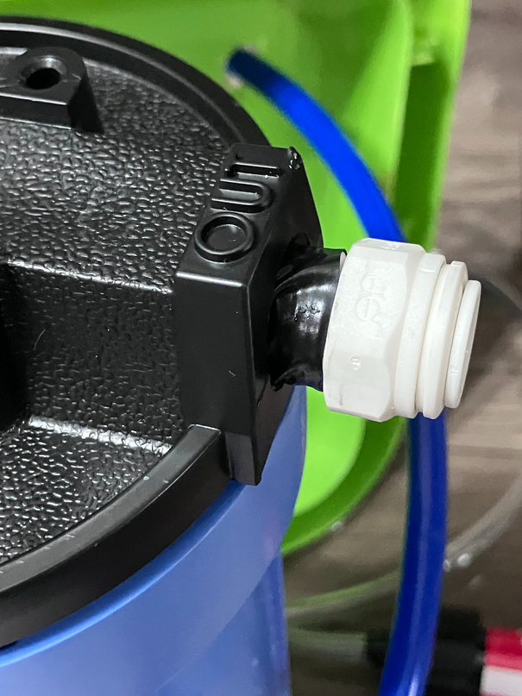
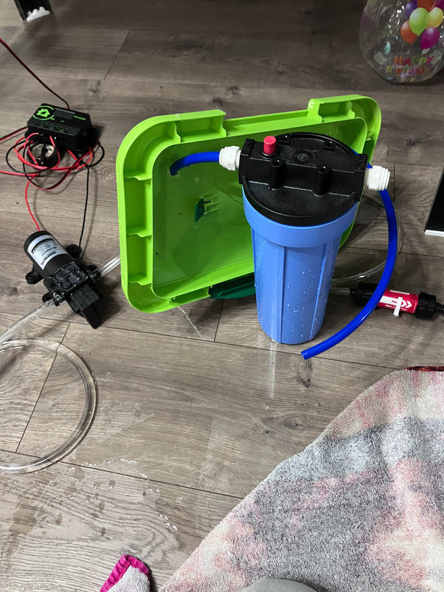
Construction
Construction required a great amount of trial and error. Many wiring mistakes were made, and lots of water was spilled. However, continued efforts of iteration and research paid off to prevent spillage between tubing.
1
2
3
Image 1: Failed wiring
Image 2: Failed sealant
Image 3: Spillage
Safety Note
Photos taken by Diya Panthulu
Safety precautions were taken when wiring to prevent electrical shock. When wiring, the student was under supervision and made sure to research connections before implementing them.

Slide 14
Functionality Test 1
Once all components were wired and connected, a functionality test was conducted to ensure everything was working correctly. The diaphragm pump worked great, and suction was solid throughout the design, giving promising flow rate results.
Functionality Test 2
When the removable water tank was filled with water, leaks were found in the jar being used. The leaks were sealed using hot glue. Then, leaks were found in the NPT threading of the sediment filter housing. After research, it was learned that NPT threads require sealant to get rid of leaks. PTFE tape, a type of sealant, was acquired and utilized to seal gaps.
Functionality Test 3
This test was successful, outputting water as designed. However, the sediment filter housing contains a leak between the housing and lid. With no acceptable material to fix this issue, the sediment filter and its housing were placed in a seperate container to prevent water from spilling.

Slide 15
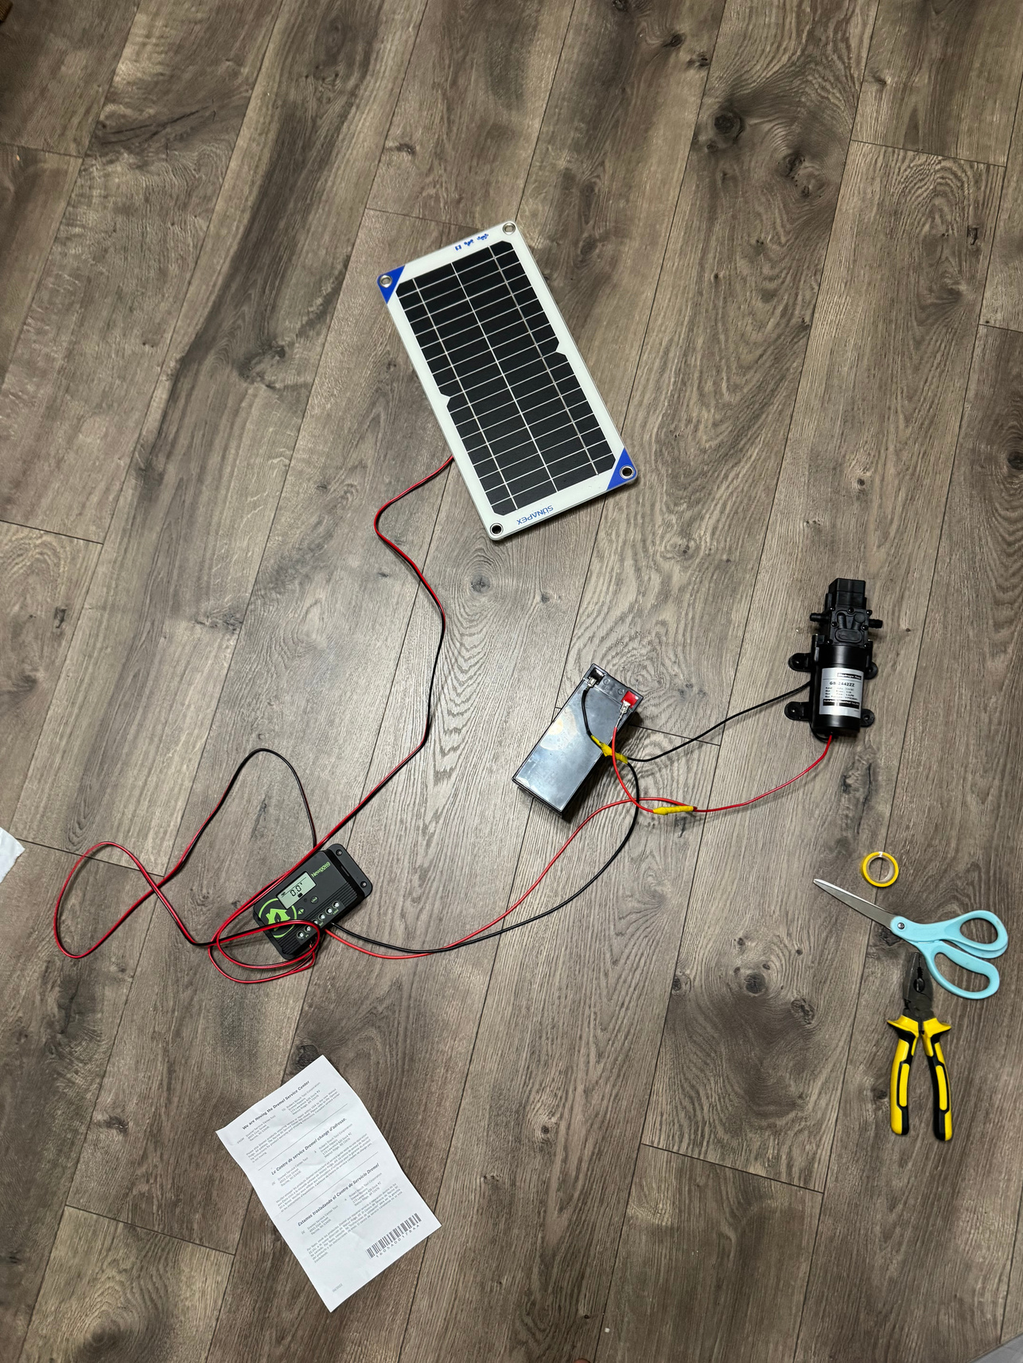
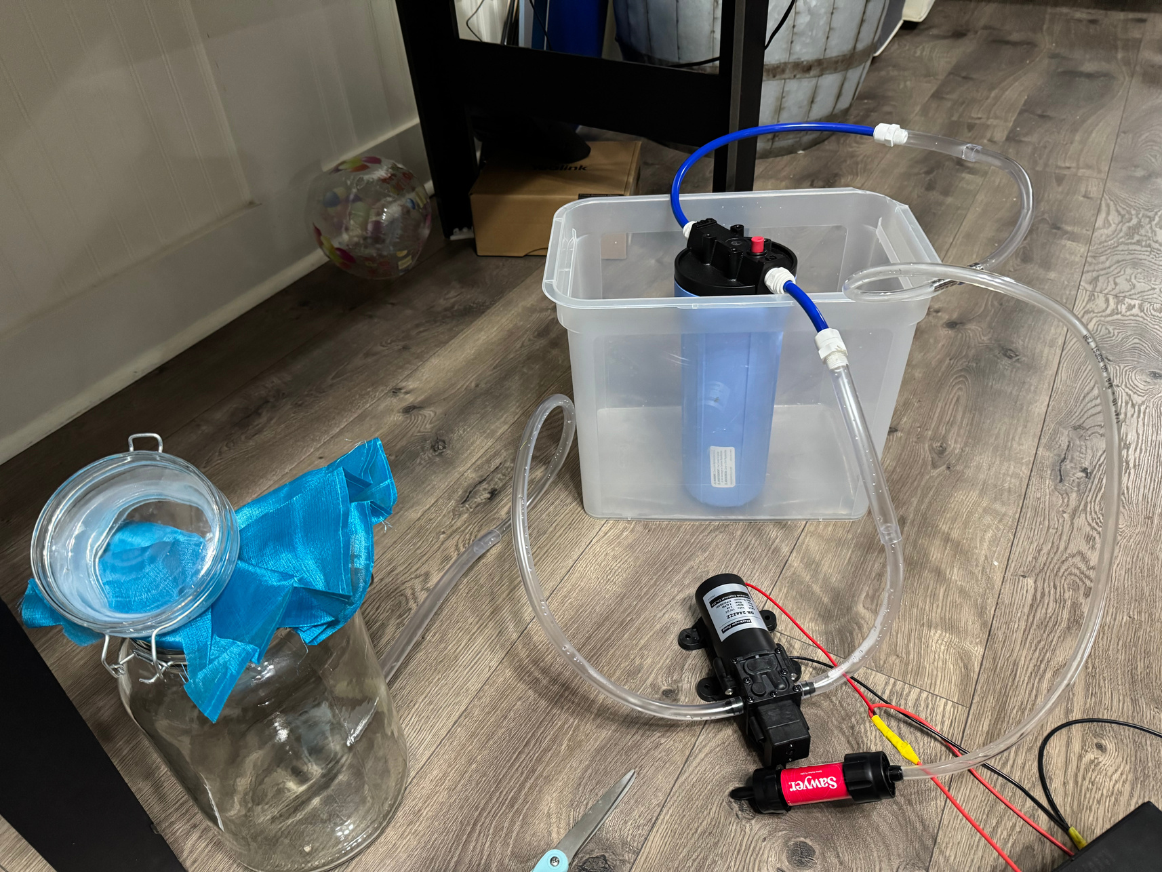
Design to be tested
Wiring System
Filtration System
Solar Panel
Sediment Filter
Diaphragm Pump
Battery
Diaphragm Pump
Charge Controller
0.1 Micron Filter
Photos taken by Diya Panthulu

Slide 16
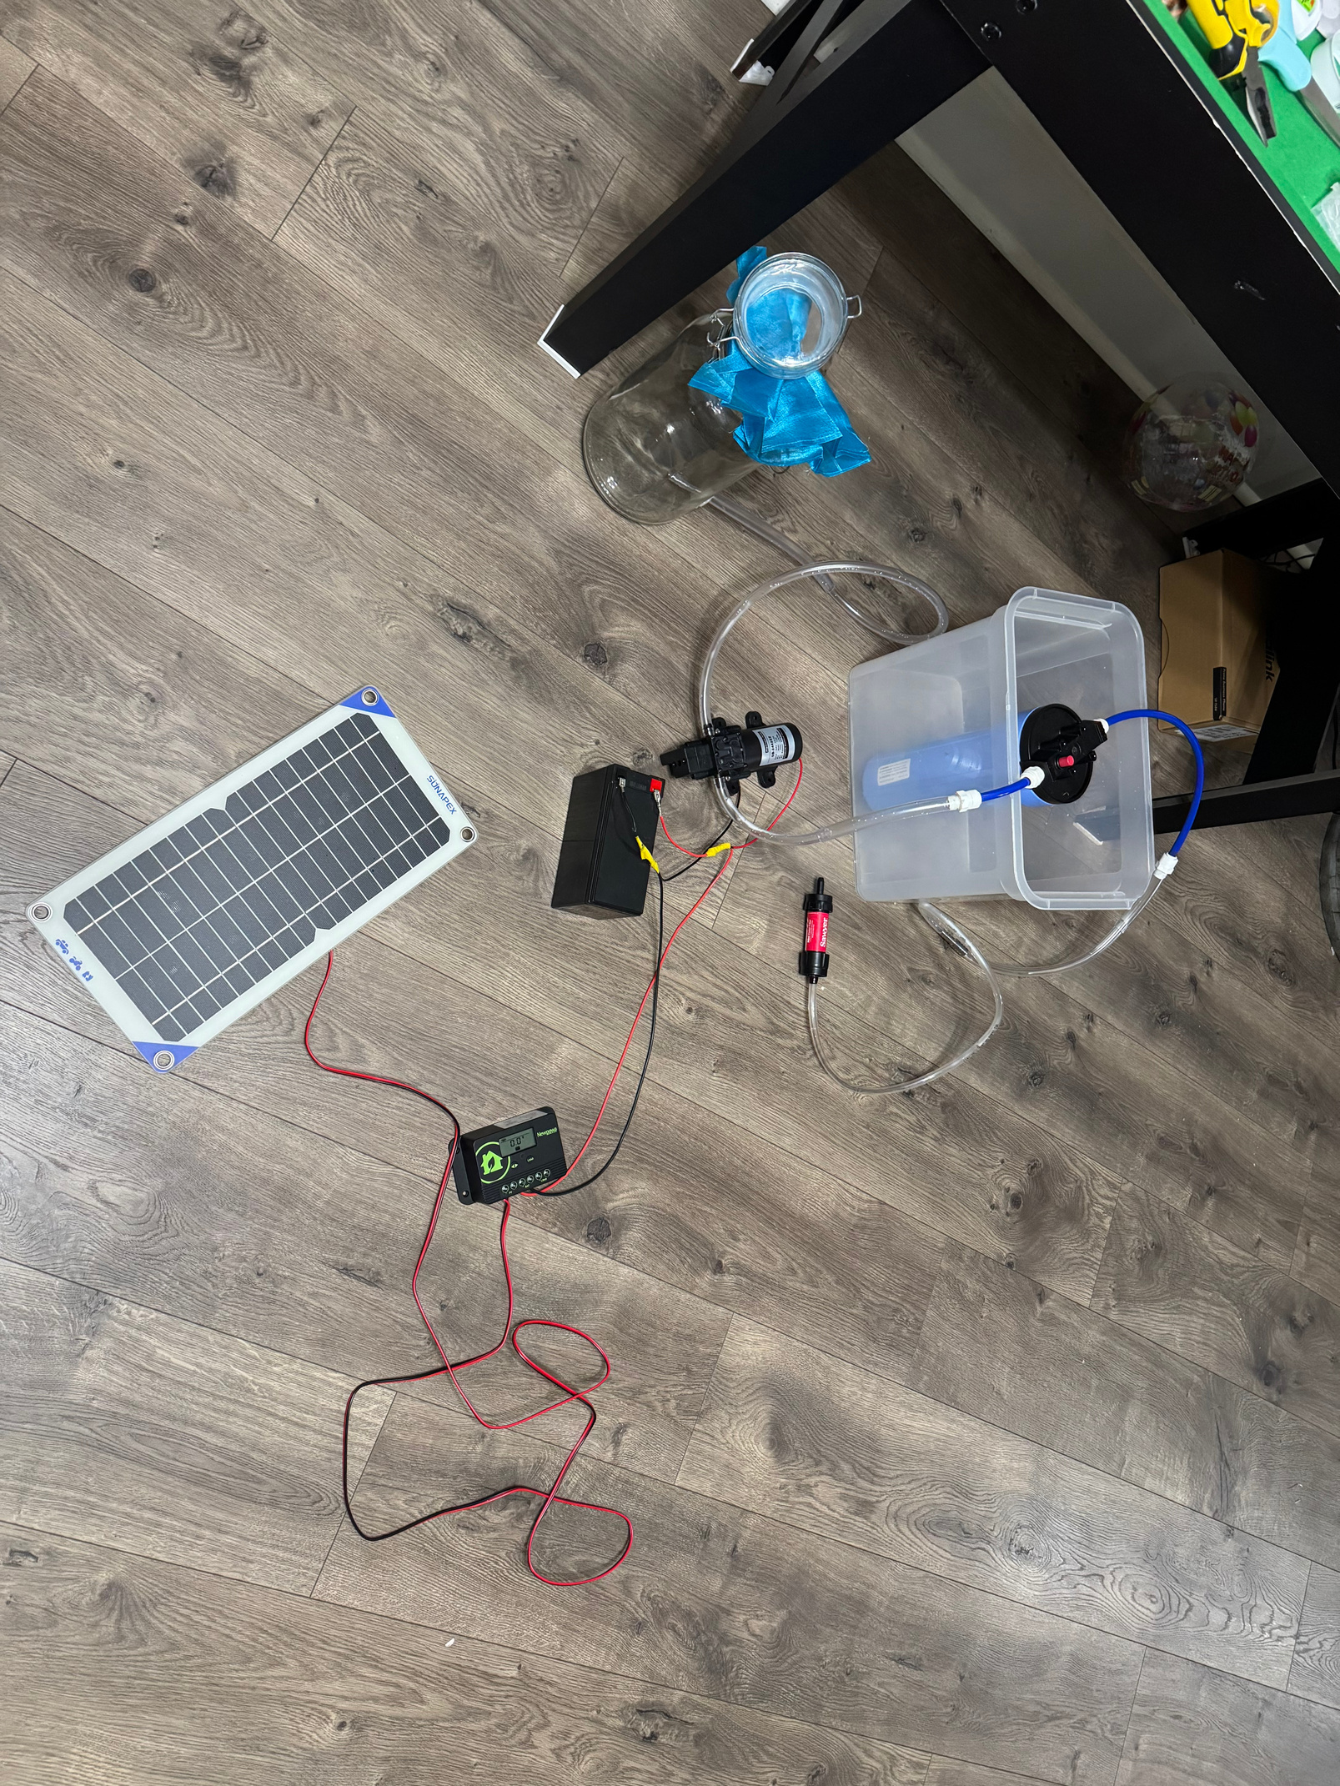

Combined System
Sediment Filter
Diaphragm Pump
Design to be tested
0.1 Micron Filter
Charge Controller
Source Water Tank
Battery
Solar Panel
Photo taken by Diya Panthulu

Slide 17
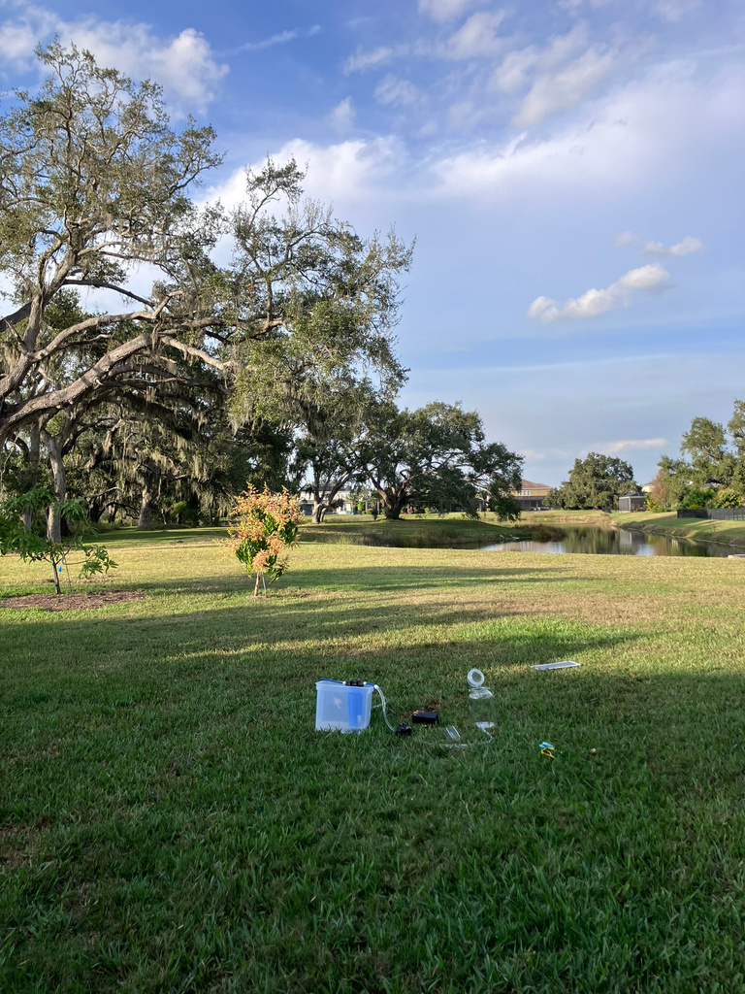
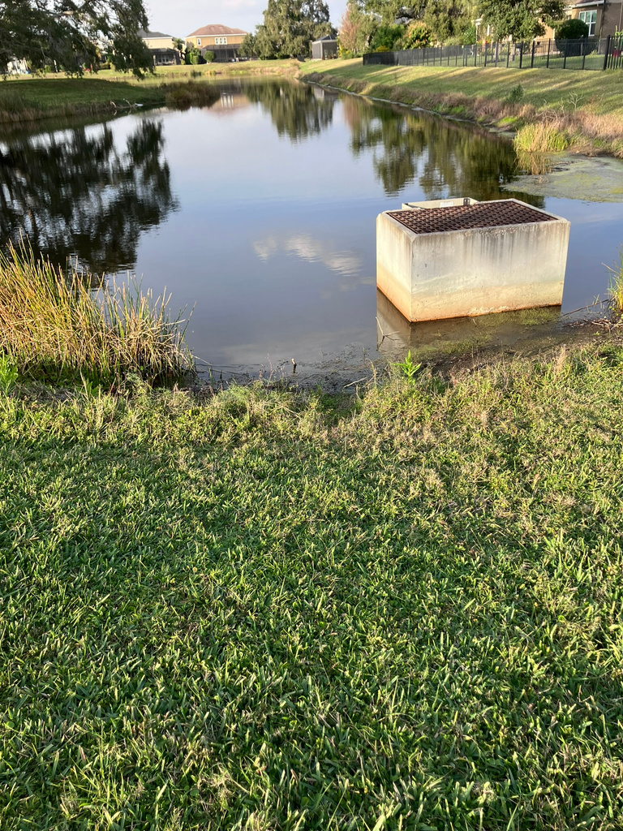
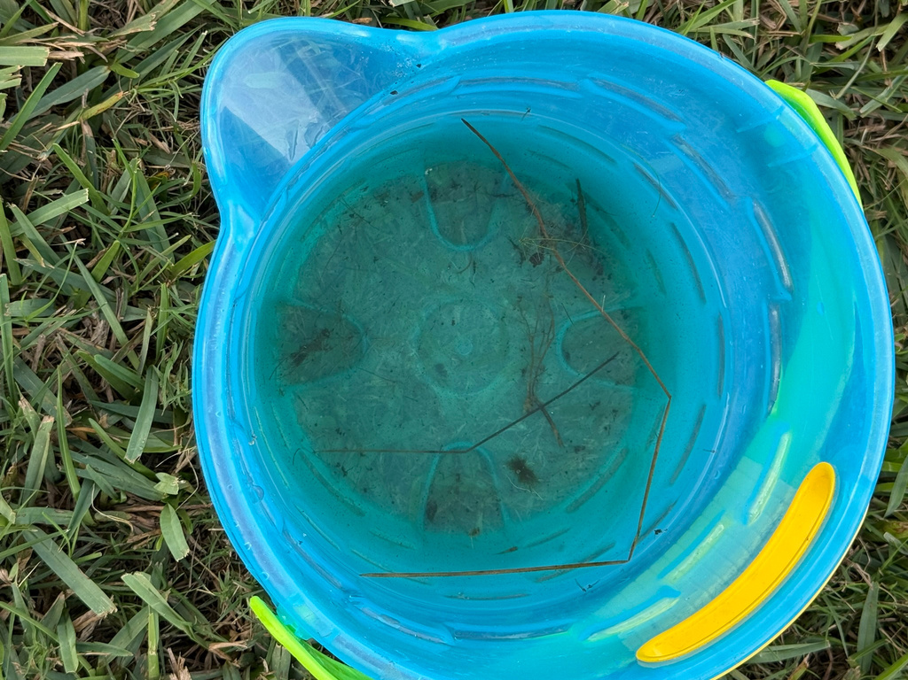
Testing Conditions
The design’s trials were conducted in sunny weather behind the student’s house on a grassy field. All components were placed down on level ground and set up properly to prepare for testing.
Image 1: Testing Area
Image 2: Water Source
Image 3: Source Water
1
2
3
Photos taken by Diya Panthulu

Slide 18
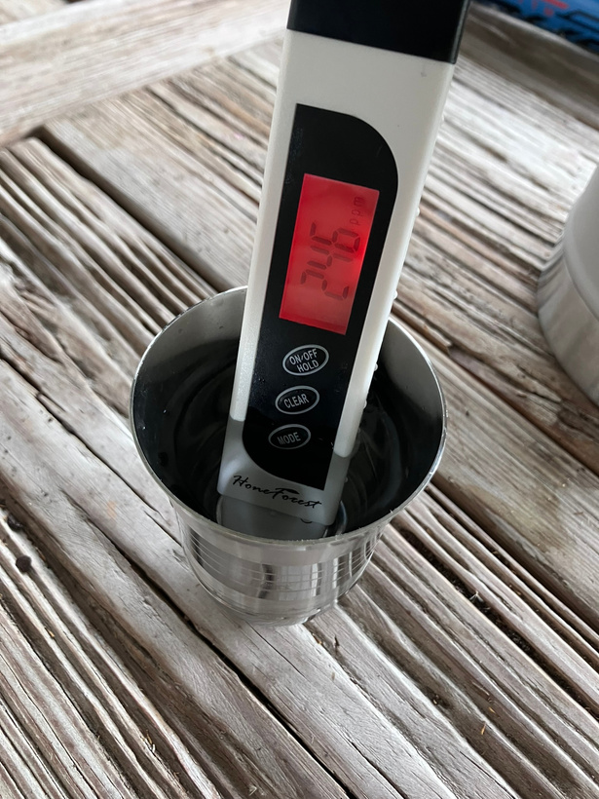
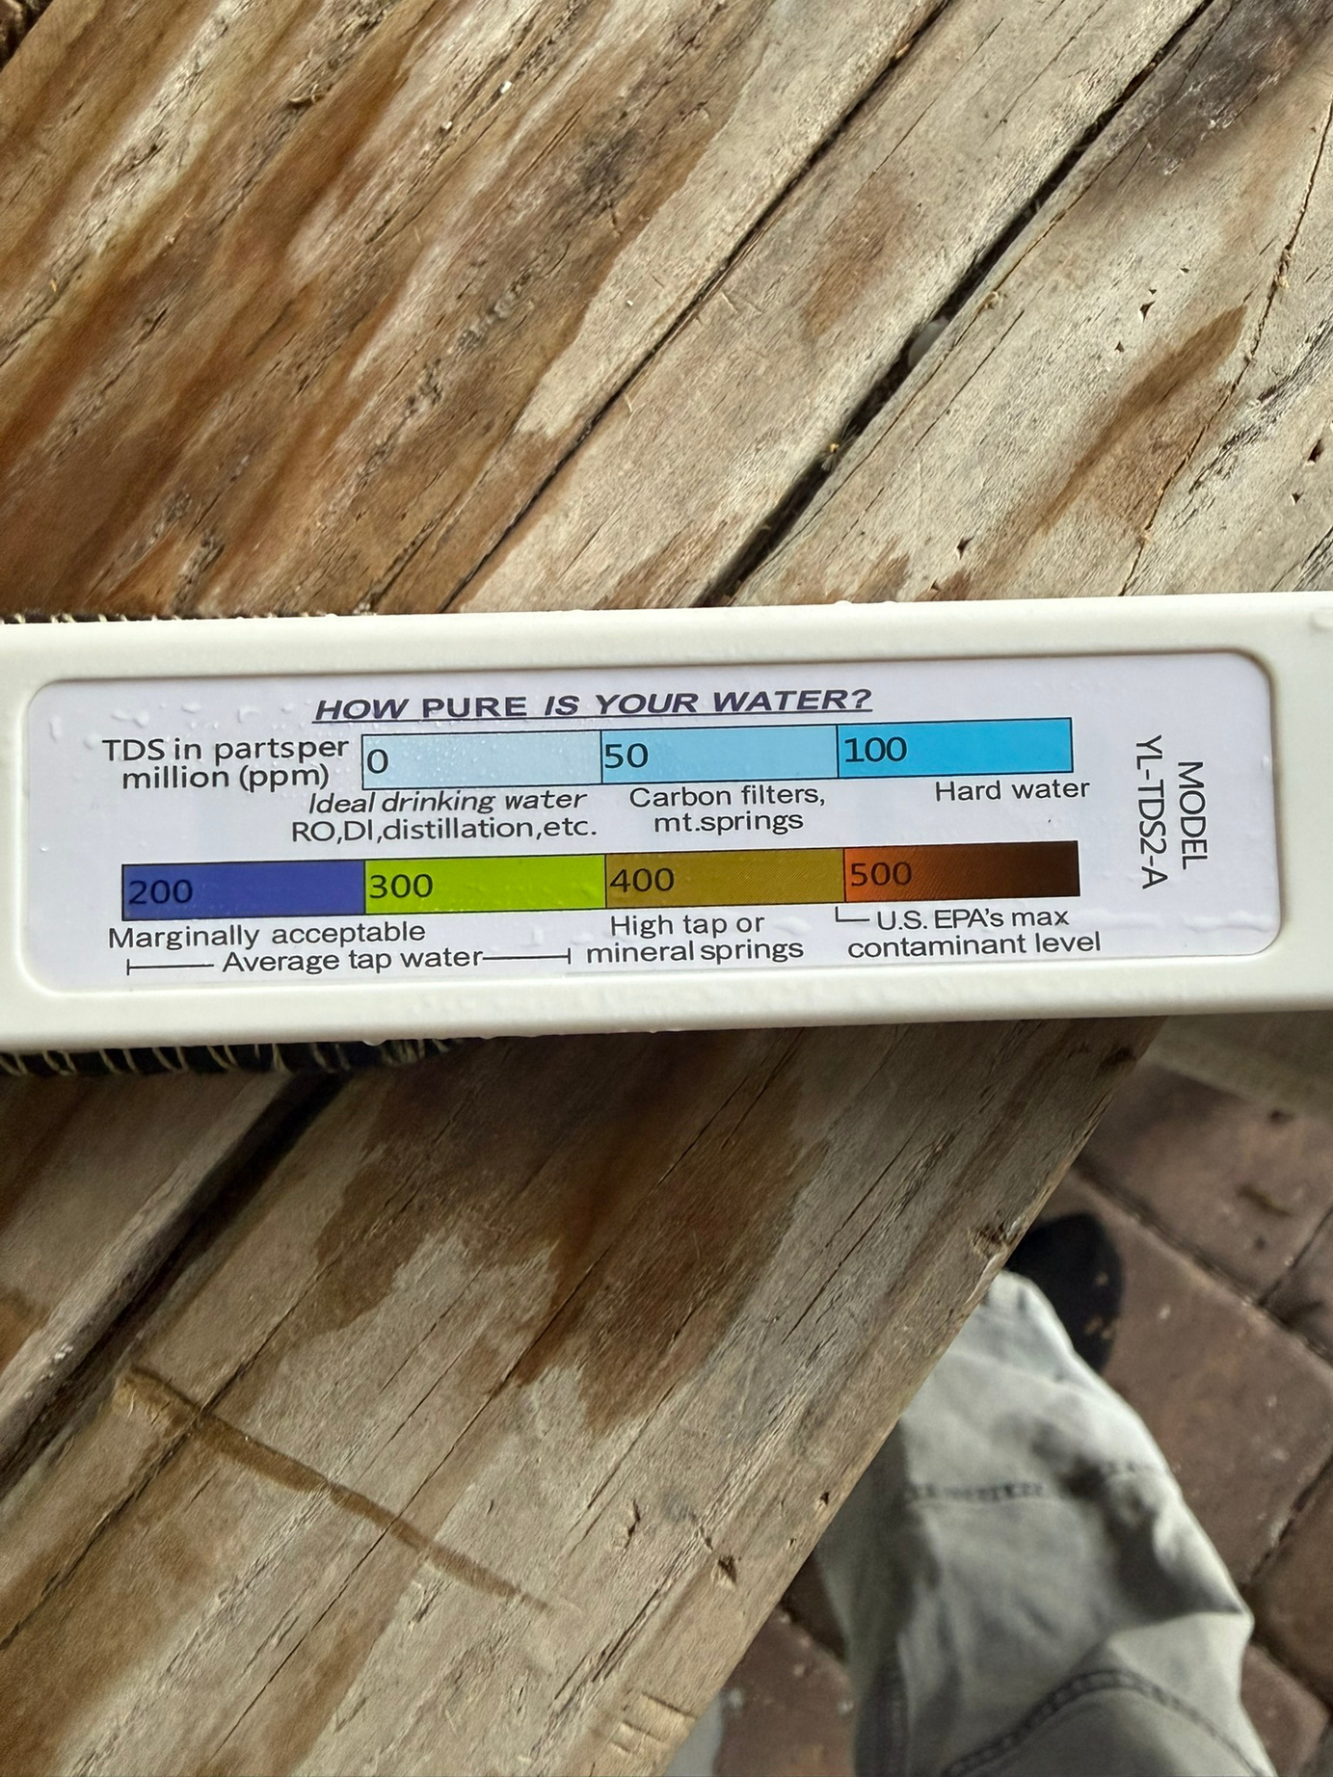
Image 1: PPM Tester Water Purity Chart
Image 2: PPM Tester reading of Tap Water
2
Photos taken by Diya Panthulu
1
Data Collection Methods
2 variables are being collected in this design- Amount of time needed to fill a 250 mL container, and ppm (parts per million) of the output/filtered water. A ppm tester and a stopwatch were used to measure this data.
Standards
Water under 500 ppm is safe to drink, according to the EPA (Environmental Protection Agency) [4]. The control, tap water from the sink, is 246 ppm.

Slide 19
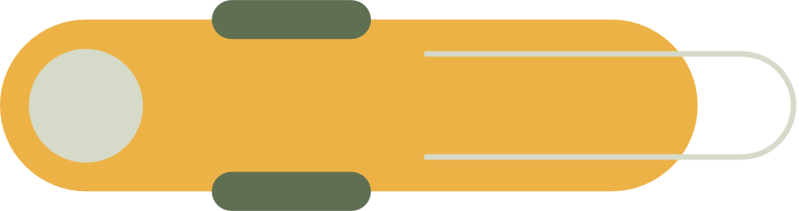
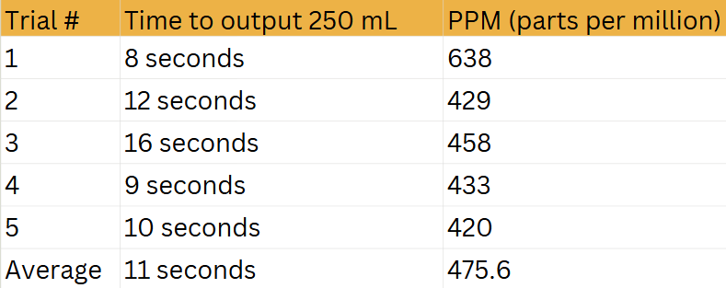
Data - Prototype v1

Slide 20
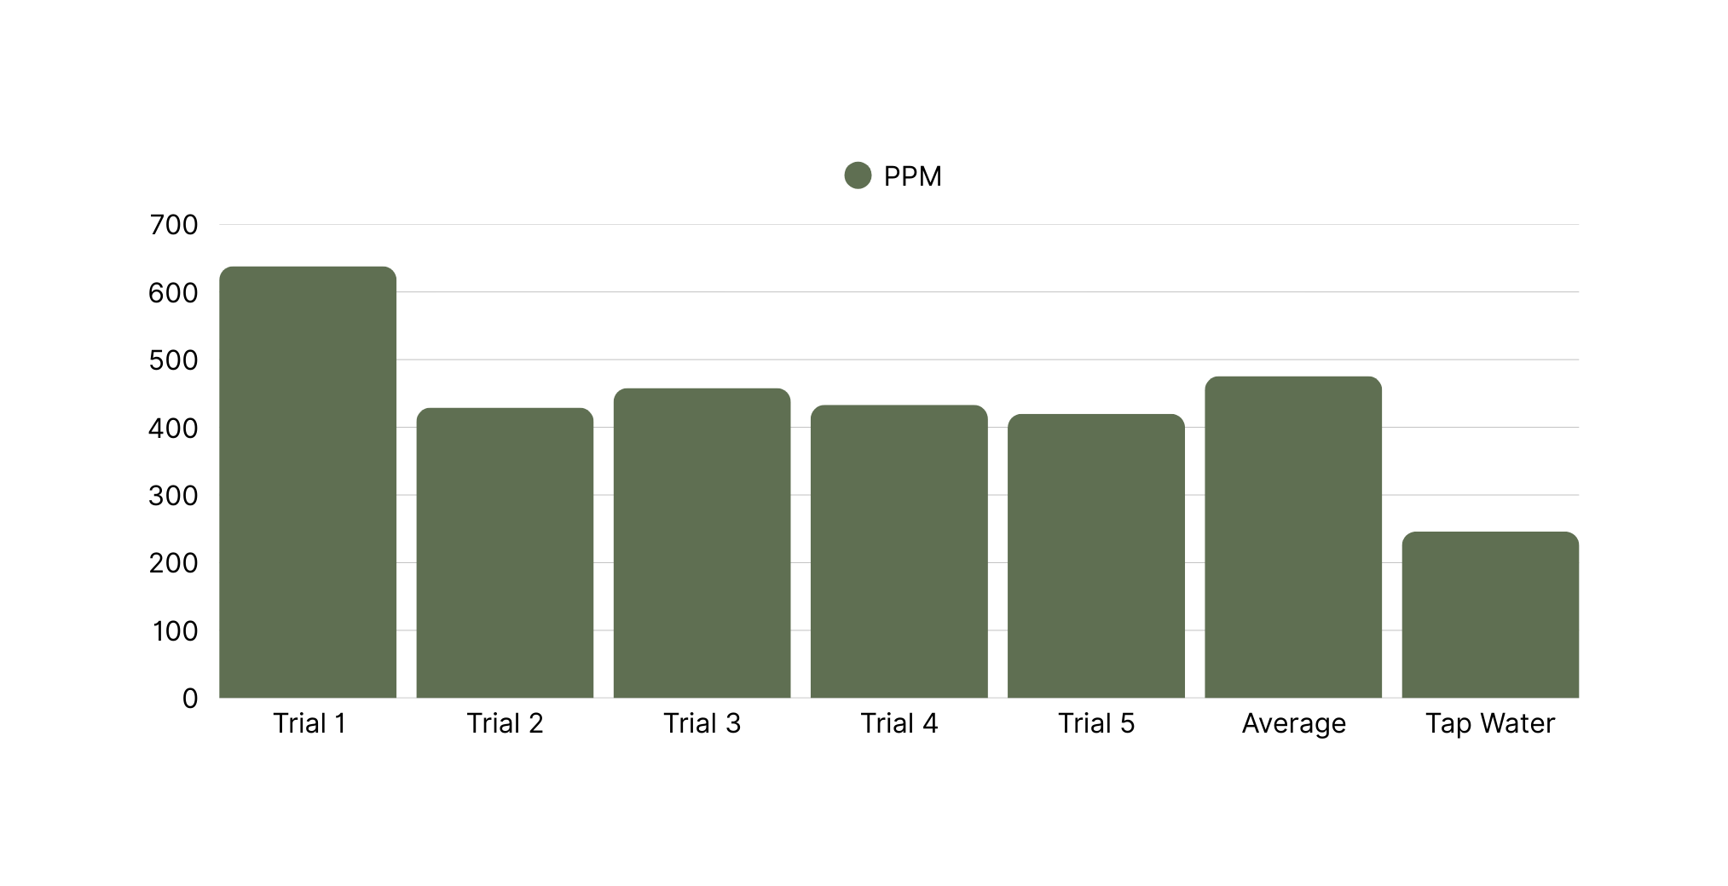
Data - Prototype V1
EPA Standard

Slide 21
Results and Analysis
Successes:
This prototype was successful and met the EPA standards 4/5 times, meeting criteria. It had an average of 475.6 ppm.
On average, this prototype had a filtration rate of 250 mL/11 seconds, or 22.72 mL/second, a safe flow rate.
Possible errors:
Trial 1 may have been an outlier piece of data, with its PPM value being much higher than other trials.
PPM values fluctuate slightly.

Slide 22
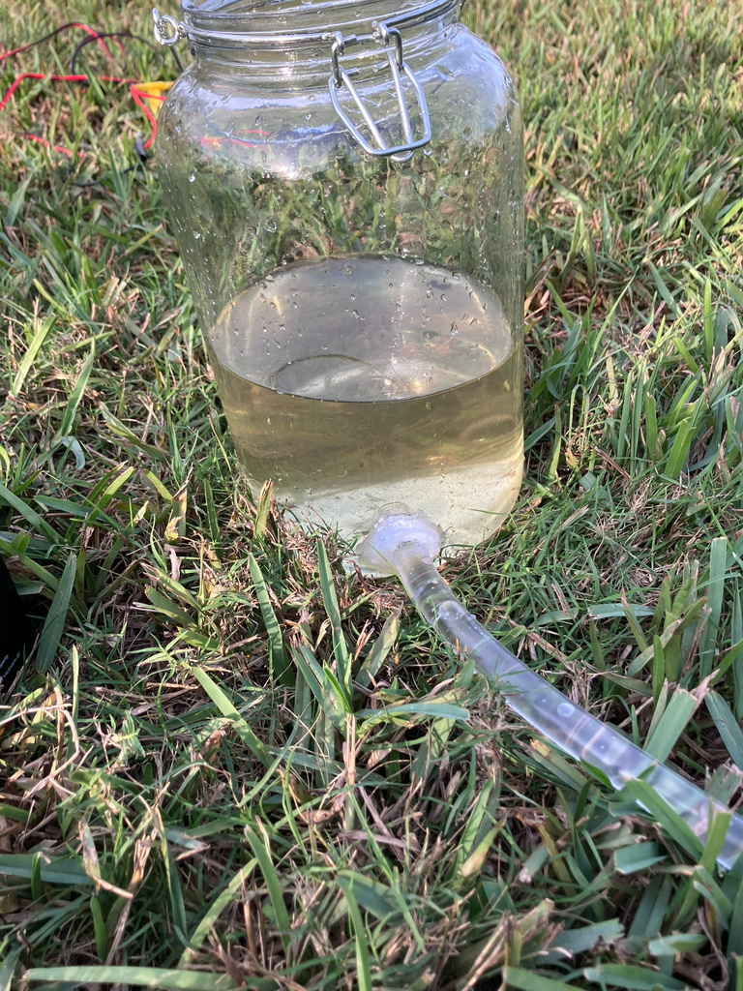
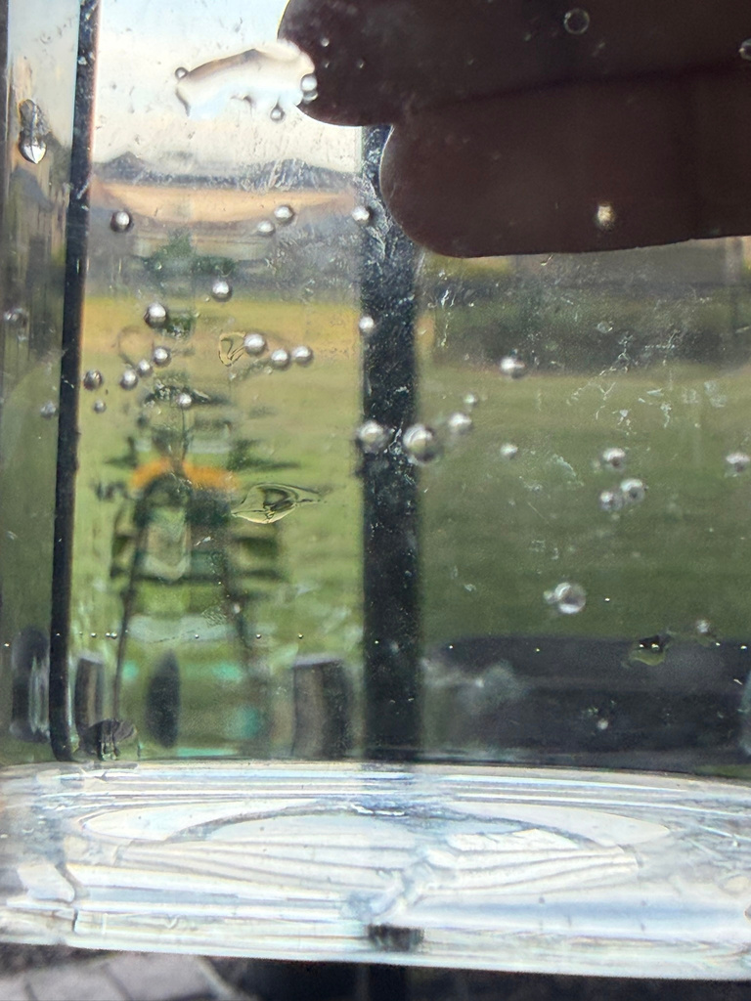
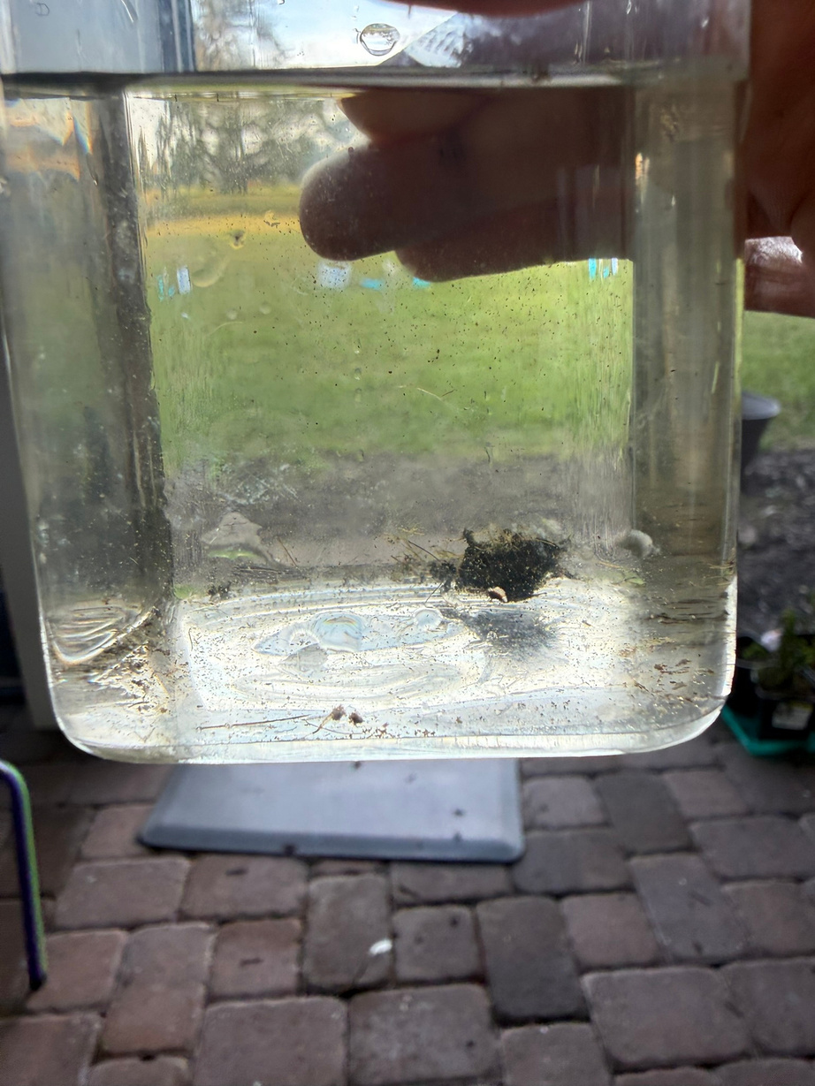
Pictures
Source Water in tank
Filtered Water Clarity
Source Water Clarity
Photos taken by Diya Panthulu

Slide 23
Observations and Iteration
When trials were conducted, the sediment in the source water was compared to the filtered water. No particles in the filtered water are visible to the eye, unlike the source water, as shown in the previous slide.
When testing, it was noticed that clumps of algae in the source water were being taken into the filter. The algae may be increasing the PPM of the water.
To solve this issue, a prefilter of cloth will be added before pouring source water into the tank. The cloth’s effect on PPM will be monitored.

Slide 24
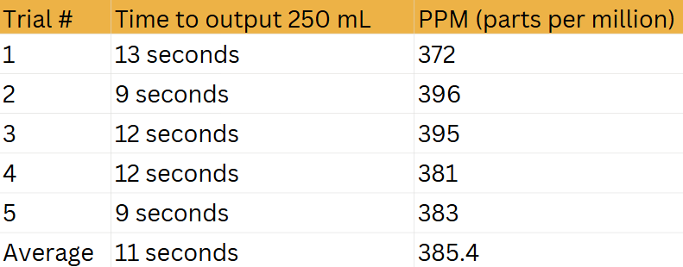
Data - Prototype v2

Slide 25
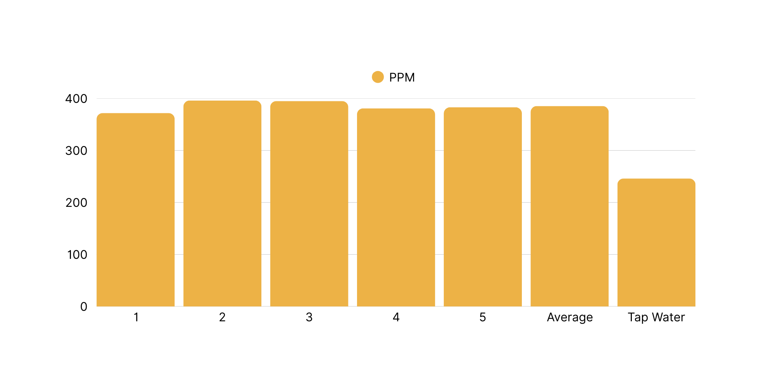
Data - Prototype V2

Slide 26
Results and Analysis
Successes:
This prototype was successful and met the EPA standards 5/5 times, meeting criteria. It had an average ppm of 385.4, lower than the previous version!
On average, this prototype had a filtration rate of 250 mL/11 seconds, or 22.72 mL/second, a safe flow rate, the same as the previous version.
Possible errors:
As stated in the previous version, PPM values fluctuate slightly.

Slide 27
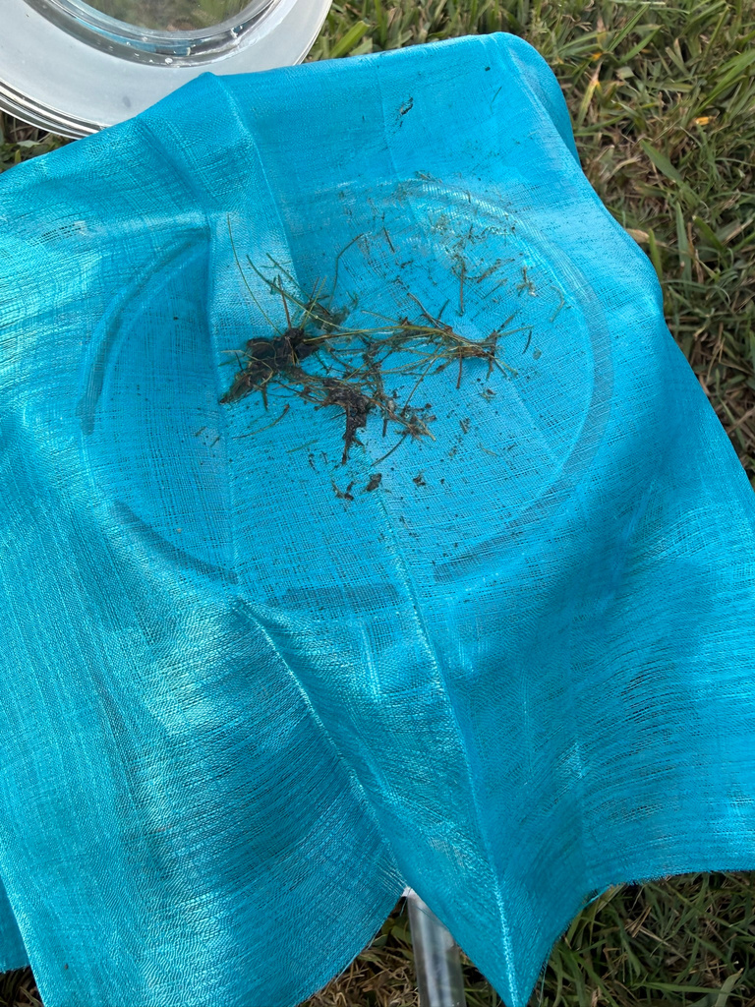
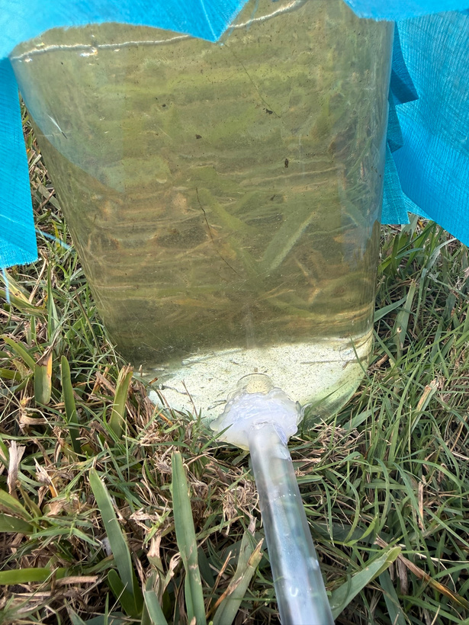
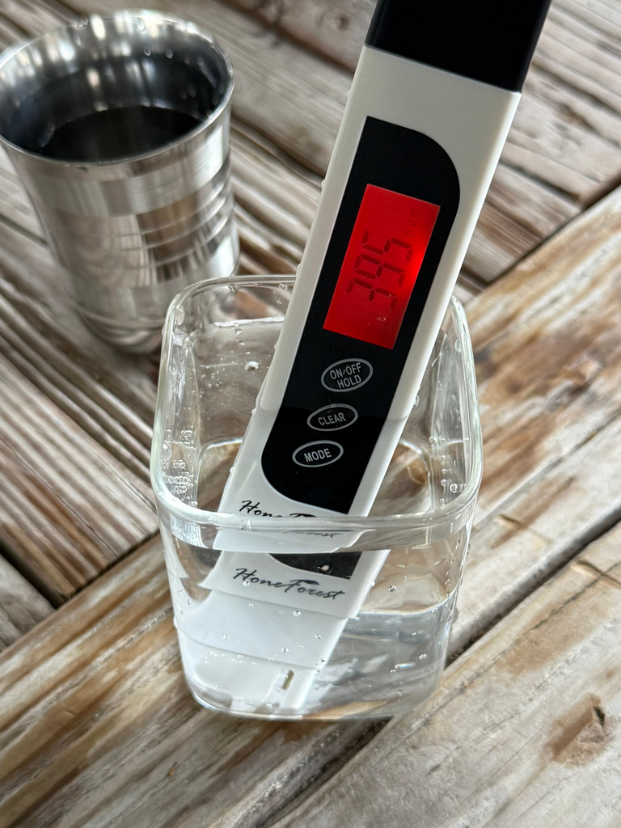
Pictures
Cloth-captured debris
Water Tank Clarity (after cloth)
Trial 3 Data Value
Photos taken by Diya Panthulu

Slide 28
Observations
Similar results were observed as in Version 1, with sediment from the source water being filtered out.
The cloth prefilter solved the issue of algae increasing PPM.

Slide 29
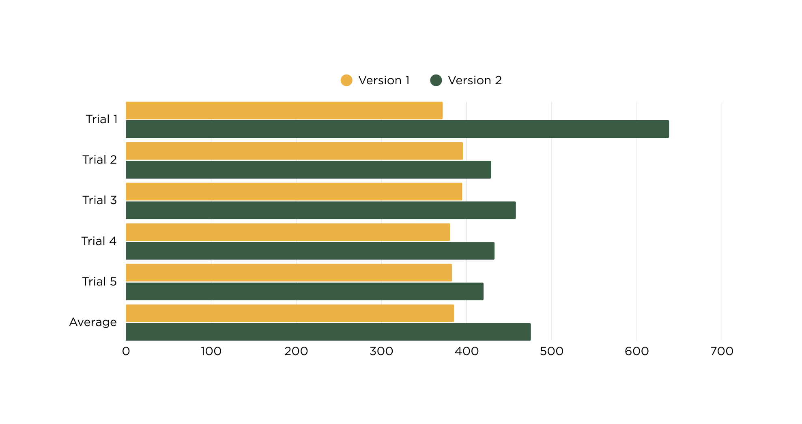
Data - Prototype V1 vs V2
EPA Standard

Slide 30
Conclusion
In this project, a solar-powered water filtration system was design, assembled, tested, and iterated to treat unfiltered water using a multi-level filtration process. The system included a solar panel, charge controller, battery backup, and diaphragm pump to power water flow, through a sediment/carbon filter and a 0.1-micron filter. This design successfully met all criteria and goals, filtering out sediment and bacteria with an average that meets EPA standards. The flow rate was safe as well, with an average of 22.72 mL/second, which falls within the optimal range for filtration, defined in criteria.
Overall, these results indicate that the system can safely and consistently filter water when operated.

Slide 31
Limitations
While the filtration system met all criteria, the system is limited by source water tank size. The system also has a major leak in the sediment housing, which, while it may be contained, is a huge limit on effectivity.
Another limitation is pressure control, with the diaphragm pump being able to generate immense pressure spikes. While the sediment housing does have a pressure release button, pressure buildup is a limitation that should be managed in future designs.
The system is also dependent on environmental conditions. While there is a battery backup that can power the system through cloudy days, environments with no sun for long periods of time may not be able to sustain this project.

Slide 32
Future Improvements
In the future, this design can be improved upon to build a sturdier, more robust system that can withstand weather conditions. Higher quality filter housings, quick connect fittings rated for higher pressures, and standardized tubing sizes (to remove the need for connectors) would improve long-term reliability.
The electrical reliability can be improved in the future as well. Adding a fuse and integrating circuit protection would improve safety. Adding a voltage display would allow for better monitoring of system performance as well!

Slide 33
Real World Applications
This system has multiple real-world applications. For example, this prototype could potentially be used for emergency and disaster relief, when electrical infrastructure is down and water sources are contaminated. A solar powered water filtration system would remove the need for electricity and provide clean, fresh water for those who need it.
Another use could be in developing countries, or rural areas with no proper water treatment systems. Once improved with increased durability, pressure control, and higher quality equipment, this system would increase water safety greatly in areas like these.

Slide 34
Works Cited
1.About choosing home water filters. (2024, April 10). Drinking Water. https://www.cdc.gov/drinking-water/prevention/about-choosing-home-water-filters.html
2.Campbell, B., & Claybourn, M. (2024, September 17). Water Filtration Systems | The 2025 Guide to Water Filters. Water Filter Guru. https://waterfilterguru.com/water-filtration-systems/
3.DixonValve. (2022, September 9). Proper NPT threads installation [Video]. YouTube. https://www.youtube.com/watch?v=JlSrX7rbCH4
4.Drinking water regulations and contaminants | US EPA. (2025, January 23). US EPA. https://www.epa.gov/sdwa/drinking-water-regulations-and-contaminants
5.EPA & U.S. Army. (2015). WHY CLEAN WATER IS IMPORTANT. In Clean Protection for Clean Water. https://www.epa.gov/sites/default/files/2016-02/documents/cleanwaterrulefactsheet.pdf
6.Our technology. (2022, March 1). LifeStraw Water Filters & Purifiers. https://lifestraw.com/pages/our-technology
7.Quick Fitting Holding Company, LLC. (2013, February 12). How to remove Push to Connect fittings [Video]. YouTube. https://www.youtube.com/watch?v=ggrb4urhv54
8.Reijnen, J. (2021, February 12). Cloth filter | Filter technology. Royal Brinkman. https://royalbrinkman.com/knowledge-center/technical-projects/water-filter-technologies-horticulture/cloth-filter
9.Ritchie, H. (2025, June 23). Two billion people don’t have safe drinking water: what does this really mean for them? Our World in Data. https://ourworldindata.org/what-no-safe-water-means
10. ScottLeeEditor. (2025, October 19). How much do HVAC UV lights cost to install? | Scott-Lee Heating. Scott-Lee Heating Company. https://scottleeheating.com/how-much-do-hvac-uv-lights-cost-to-install/
11. Standing, K. (2025, July 20). Thread Sealants 101: What to use for NPT and BSP fittings. Industrial Electrical Warehouse. https://industrialelectricalwarehouse.com/blogs/news/thread-sealants-101-what-to-use-for-npt-and-bsp-fittings
12. Systems, G. P. (2025, November 6). How many microns should your water filter be. Gopani Filters Private Limited. https://www.gopani.com/blog/how-many-microns-should-your-water-filter-be/
13. The Filtered Files - Filters Fast - Your #1 Resource for Air and Water Filtration Related Information. (2025, April 2). A simple guide to water filtration - the Filtered Files - Filters Fast - your #1 resource for air and water filtration related information. https://blog.filtersfast.com/blog/guide-to-water-purification/
14. Water Quality Association. (2023, July 3). Bacteria & Virus - Water Quality Association. https://wqa.org/resources/bacteria-virus/
15. Why is it important to filter water? (n.d.). aquasana.com. https://www.aquasana.com/info/why-is-it-important-to-filter-water-pd.html?srsltid=AfmBOorXguX7H4E5URVKmeHzEX9SZHFG4p0DtfGyQbYVTHEcc1dZ00bT
16. World Health Organization: WHO. (2023, September 13). Drinking-water. https://www.who.int/news-room/fact-sheets/detail/drinking-water
17. World Health Organization: WHO. (2025, August 26). 1 in 4 people globally still lack access to safe drinking water – WHO, UNICEF. WHO Int. https://www.who.int/news/item/26-08-2025-1-in-4-people-globally-still-lack-access-to-safe-drinking-water---who--unicef

Slide 35
LInks
Github Repository
https://github.com/dipa-cotton/scifair2526/
Youtube Presentation
https://youtube.com/shorts/OhdTZ03Goxc?feature=share
Thank you!!!

